Slide 1


Introduction
Slides by Kevin Wayne.
Copyright © 2005 Pearson-Addison Wesley.
All rights reserved.

Slide 2
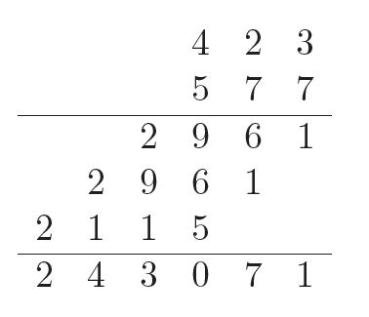
Algorithms
Algorithm.
  [Knuth] An algorithm is a finite, definite, effective procedure, with some input and some output.
  Grade-school algorithm for computing addition.
  Multiplication by repeated addition: compute x×y by adding x to itself y times.
  Grade-school algorithm for multiplication.
Notes:
http://portal.newman.wa.edu.au/technology/12infsys/html/KWH2003/KnuthAlgorDef.htm
"Finite: there must be an end to it within a reasonable time.
Definite: precisely definable in clearly understood terms, no pinch of salt type vagaries, or possible ambiguities
Effective: the steps must be actually be able to be carried out. [simple enough for someone using pencil and paper to carry out in a finite amount of time]
Procedure: the sequence of specific steps arranged in a logical order.
Output: unless there is something coming out of the process, the result will remain unknown! "

Slide 3
Applications
Wide range of applications.
  Databases.
  Scheduling.
  Networking.
  Data analysis.
  Signal processing.
  Computer graphics.
  Scientific computing.
  Operations research.
  Artificial intelligence.
  Computational biology.
  . . .
We focus on algorithms and techniques that are useful in practice.

Slide 4
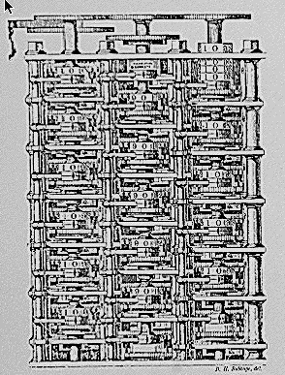
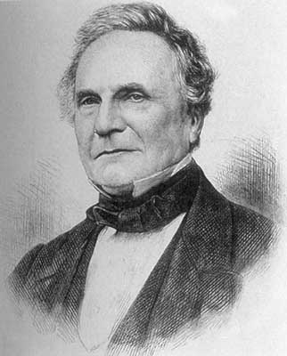
Theory of Algorithms
"As soon as an Analytic Engine exists, it will necessarily guide the future course of the science. Whenever any result is sought by its aid, the question will arise - By what course of calculation can these results be arrived at by the machine in the shortest time? - Charles Babbage
Notes:
His 19th century machine would have been first (mechanical) computer had he only succeeded in building it. His strikingly modern thought is nowadays more valid than ever, because the faster your computing equipment, the more you stand to gain from efficient algorithms. (Brassard + Bratley, p. xv)
A strikingly modern thought.

Slide 5
Algorithmic Paradigms
Design and analysis of computer algorithms.
  Greed.
  Divide-and-conquer.
  Dynamic programming.
  Network flow.
  Intractability.
  Approximation algorithms.
  Local search
  Randomized algorithms.
  . . .
Notes:
* broad algorithmic themes and design principles
* paradigmatic problems and approaches that illustrate, with minimal amount of irrelevant detail, basic approaches in designing efficient algorithms. At the same time, it would be pointless to pursue design principles in a vacuum - we consider problems drawn from fundamental issues that arise throughout cs and elsewhere
* we also address fundamental barriers that prevent design of efficient algorithms

Slide 6
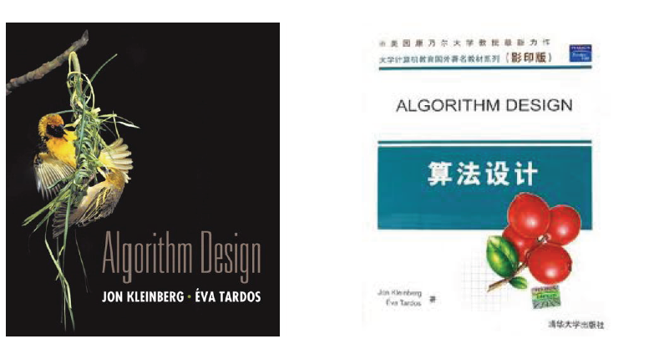
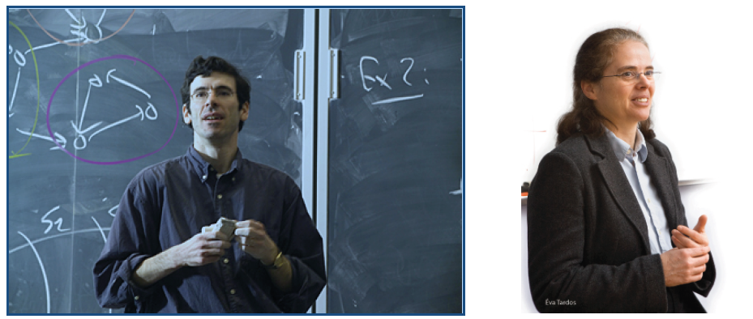
Textbook
Kleinberg J and Tardos É. Algorithm Design. Prentice Hall, 2005, Tsinghua Press, 2006.
Notes:
* broad algorithmic themes and design principles
* paradigmatic problems and approaches that illustrate, with minimal amount of irrelevant detail, basic approaches in designing efficient algorithms. At the same time, it would be pointless to pursue design principles in a vacuum - we consider problems drawn from fundamental issues that arise throughout cs and elsewhere
* we also address fundamental barriers that prevent design of efficient algorithms

